Slide 1


OPTIMIZING AGRICULTURE PRODUCTION ENGINE
Mini Project Presentation on
Presented By-
Milind Udbhav (1901010044)
B.TECH(CSE)

Slide 2
Understanding the Problem Statement
Agriculture is the art and science of cultivating the soil ,growing crops and raise livestock.
Agriculture is the process of producing food,fiber and many other desired products by the cultivation of certain plants.
Agriculture makes us less dependent on other foreign countries as it provides food and also provides income to farmers and revenue to the government.

Slide 3

Objective of the project
Build a predictive model based on machine learning technology which could suggest the most suitable crops to grow based on the available climatic and soil conditions.
The goal is to achieve precision farming by optimizing the agriculture production.
The project is intended on precision farming

Slide 4
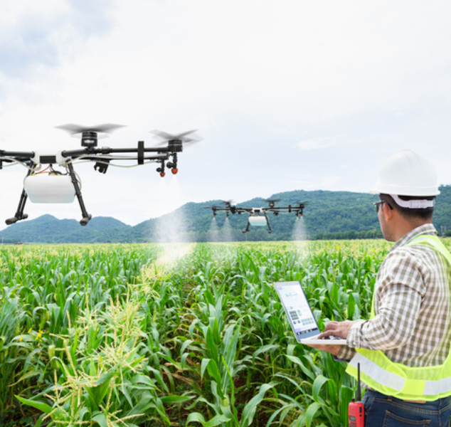
Real life Implications of the Project
It will also help to cope with weather unpredictability.
By using this technique, it will help farmers to understand about the requirement of crops and increase its productivity.

Slide 5
Important parameters for finding best solutions required by the crops
Nitrogen
(N)
Phosphorus
(P)
Potassium
(K)
Temperature
(temperature in degree Celsius)
Humidity
(relative humidity in %)
Ph
(ph value of the soil)
Rainfall
(rainfall in mm)
Label
(Names of different crops)

Slide 6
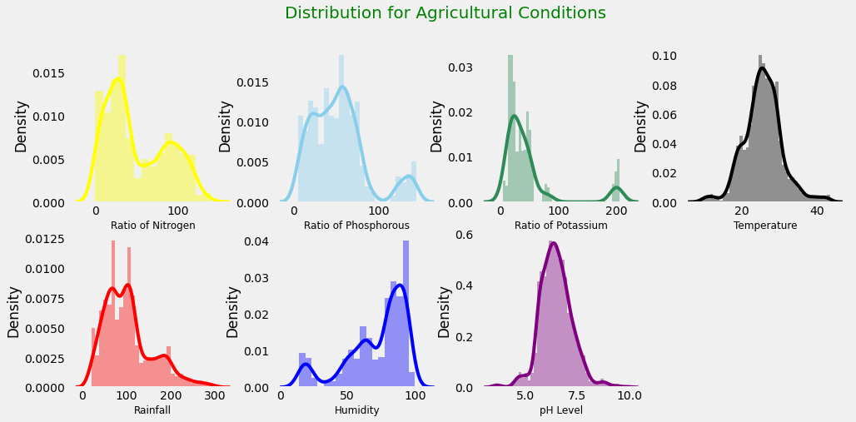

Slide 7
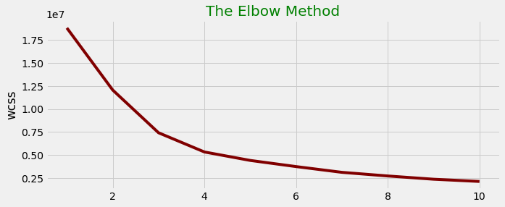
Clustering is the process of grouping data points with similar traits and assigning them into clusters.
The number of clusters present in the data can be found using elbow method.
Elbow method is the way to find number of clusters present in dataset and no. of clusters are plotted with errors are plotted to find elbow .
The no. of clusters which we get are the optimum clusters for the dataset.
In this picture we have two elbows on 3 and 4out of which we will choose the last elbow. Through this no. of clusters are known.

Slide 8
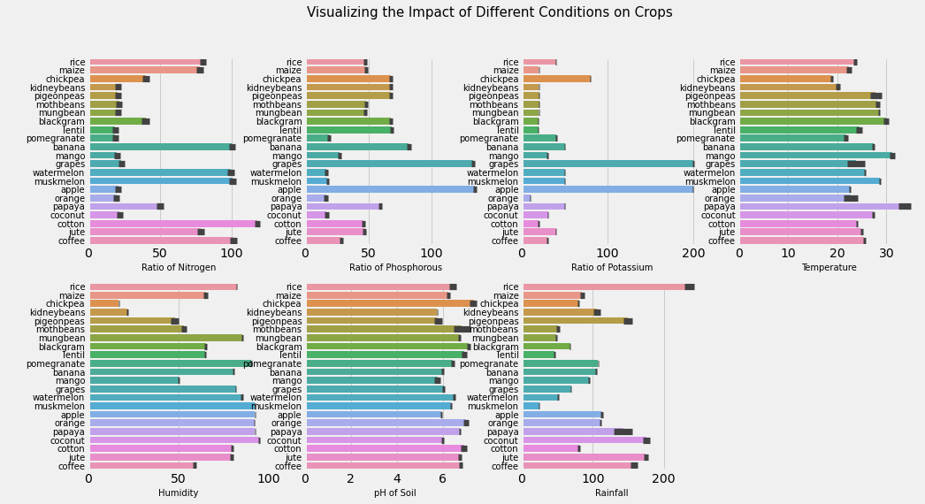

Slide 9
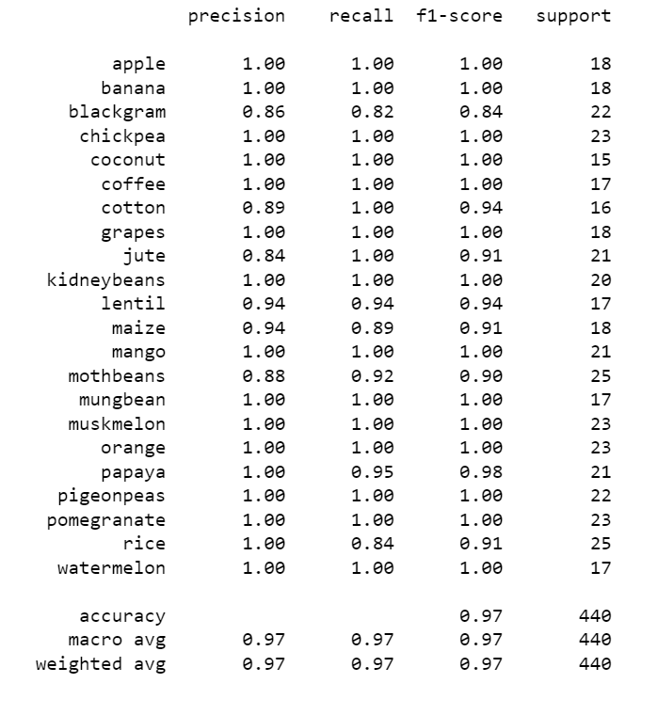
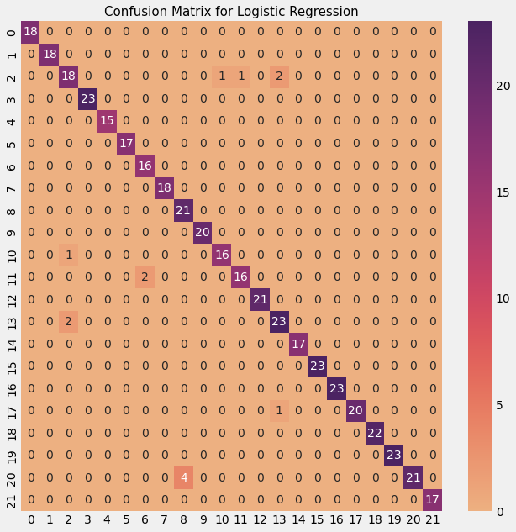

Slide 10

As mentioned in figure Confusion-matrix is a grid of Machine learning values used to evaluate the performance of supervised classification algorithms. It may also compute several metrics from this grid to give the model a score, including precision, recall, and the F1 score. This model helps to decide whether it is accurate or not . It also shows that there are multiple possibilities and probability cases which shows that how efficiently logistic regression work compared to other model by increasing its accuracy and performance.

Slide 11
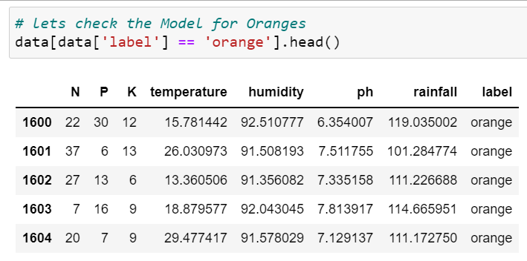
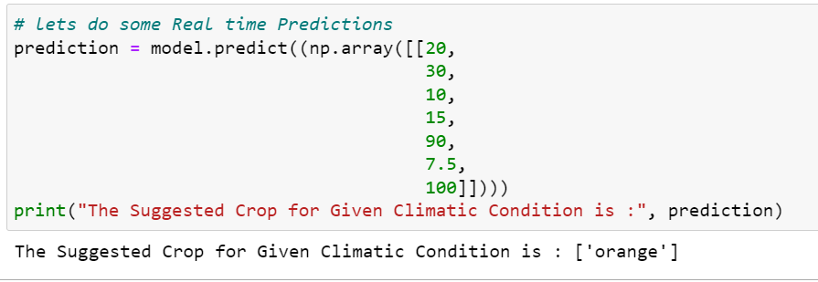

Slide 12

Conclusion
We learnt about the use of statistics in summarizing the major facts about the data.
We got the general information about the conditions to be taken care of while growing different crops.
We learn the importance of ipywidgets to make the function more interactive to the user.
We learnt about the importance of clustering analysis.
Importance of data visualization was known to find hidden trends and logistic regression works well for real life condition.

Slide 13

Thank you !

